Slide 1

The I²C Bus

Slide 2
The I²C Bus
What is the I²C Bus and what is it used for?
Bus characteristics
I²C Bus Protocol
Data Format
Typical I²C devices
Example device
Sample pseudo code

Slide 3
What is I²C
The name stands for “Inter - Integrated Circuit Bus”
A Small Area Network connecting ICs and other electronic systems
Originally intended for operation on one
single board / PCB
  Synchronous Serial Signal
  Two wires carry information between
  a number of devices
  One wire use for the data
  One wire used for the clock
Today, a variety of devices are available with I²C Interfaces
  Microcontroller, EEPROM, Real-Timer, interface chips, LCD driver, A/D converter

Slide 4
What is I²C used for?
Data transfer between ICs and systems at relatively low rates
  “Classic” I²C is rated to 100K bits/second
  “Fast Mode” devices support up to 400K bits/second
  A “High Speed Mode” is defined for operation up to 3.4M bits/second
Reduces Board Space and Cost By:
  Allowing use of ICs with fewer pins and smaller packages
  Greatly reducing interconnect complexity
  Allowing digitally controlled components to be located close to their point of use

Slide 5
I²C Bus Characteristics
Includes electrical and timing specifications,
and an associated bus protocol
Two wire serial data & control bus implemented with the serial data (SDA) and clock (SCL) lines
  For reliable operation, a third line is required:
  Common ground
Unique start and stop condition
Slave selection protocol uses a 7-Bit slave address
  The bus specification allows an extension to 10 bits
Bi-directional data transfer
Acknowledgement after each transferred byte
No fixed length of transfer

Slide 6
I²C Bus Characteristics (cont’d)
True multi-master capability
  Clock synchronization
  Arbitration procedure
Transmission speeds up to 100Khz
(classic I2C)
Max. line capacitance of 400pF,
approximately 4 meters (12 feet)
Allows series resistor for IC protection
Compatible with different IC technologies

Slide 7
I²C Bus Definitions
Master:
  Initiates a transfer by generating
  start and stop conditions
  Generates the clock
  Transmits the slave address
  Determines data transfer direction
Slave:
  Responds only when addressed
  Timing is controlled by the clock line

Slide 8
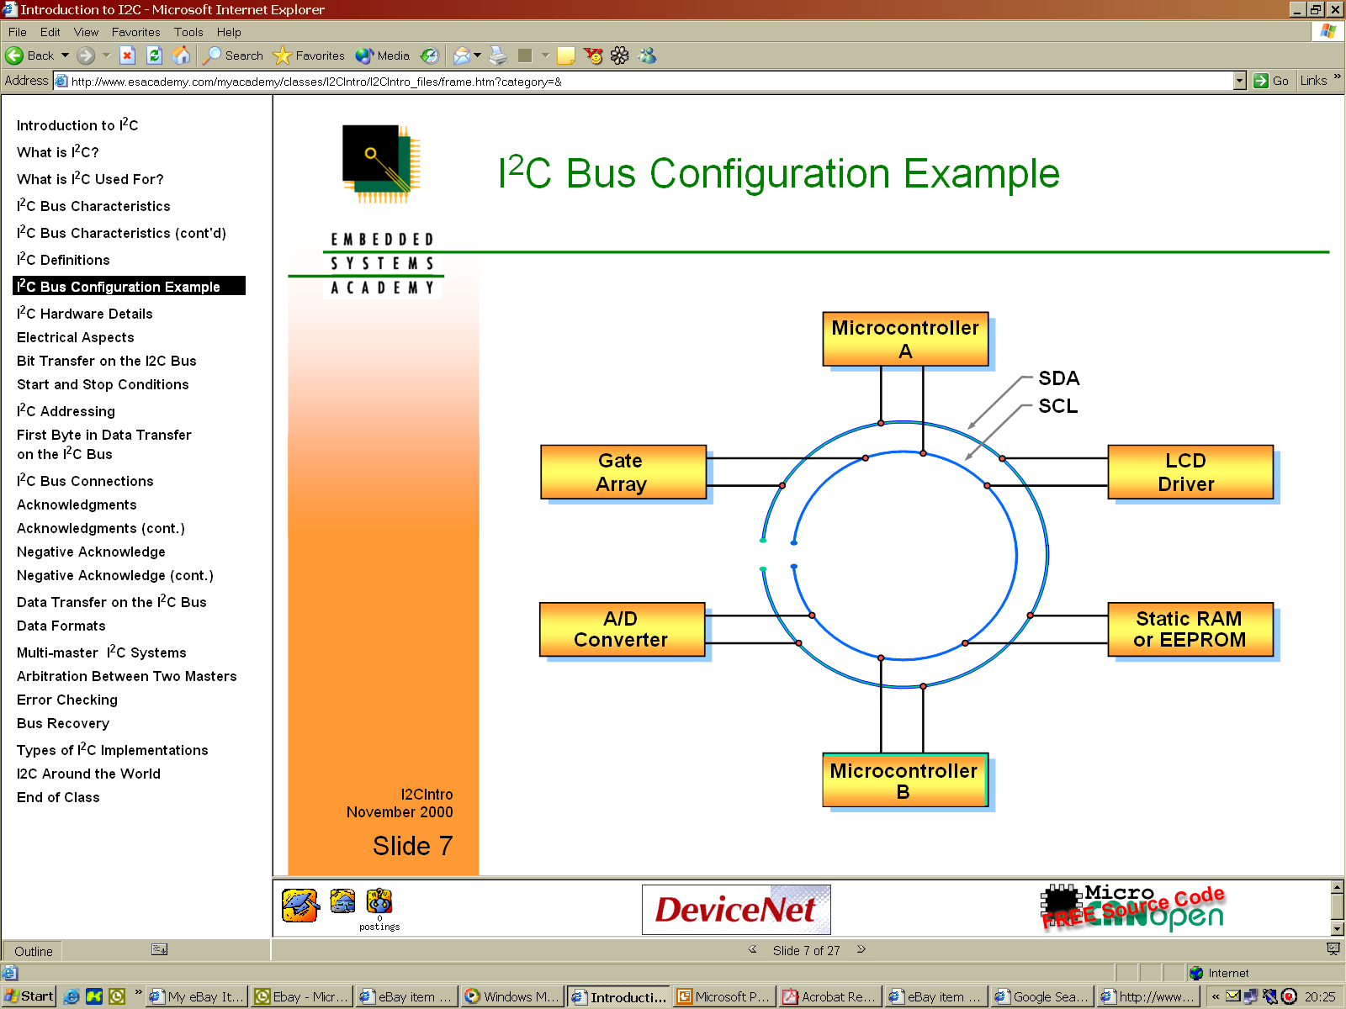
I²C Bus Configuration Example

Slide 9
I²C Hardware Details
Devices connected to the bus must have an open drain or open collector output for serial clock and data signal
The device must also be able to sense the logic level on these pins
All devices have a common ground reference
The serial clock and data lines are connected to Vdd(typically +5V) through pull up resistors
At any given moment the I2C bus is:
  Quiescent (Idle), or
  in Master transmit mode or
  in Master receive mode.

Slide 10
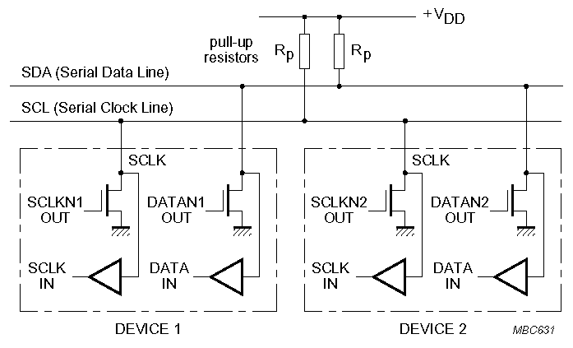
I²C Electrical Aspects
I²C devices are wire ANDed together.
If any single node writes a zero, the entire line is zero

Slide 11
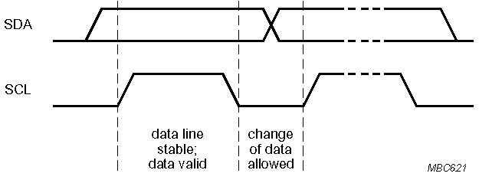
Bit Transfer on the I²C Bus
In normal data transfer, the data line only changes state when the clock is low
SDA
SCL
Data line stable; Data valid
Change of data allowed

Slide 12
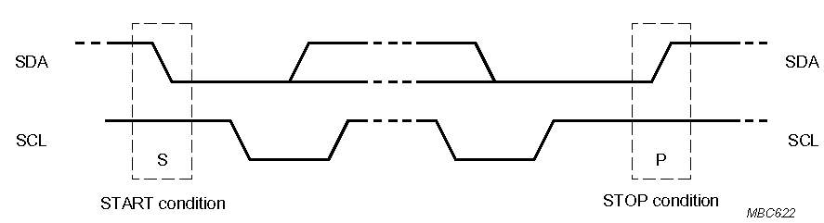
Start and Stop Conditions
A transition of the data line while the clock line is high is defined as either a start or a stop condition.
Both start and stop conditions are generated by the bus master
The bus is considered busy after a start condition, until a stop condition occurs
SDA
SDA
SCL
SCL
Start Condition
Stop Condition

Slide 13
I²C Addressing
Each node has a unique 7 (or 10) bit address
Peripherals often have fixed and programmable address portions
Addresses starting with 0000 or 1111 have special functions:-
  0000000 Is a General Call Address
  0000001 Is a Null (CBUS) Address
  1111XXX Address Extension
  1111111 Address Extension – Next Bytes are the Actual Address

Slide 14
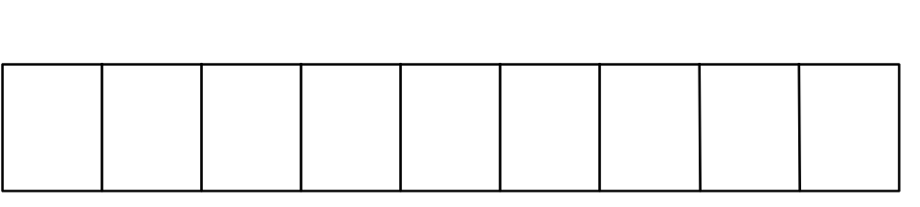
First Byte in Data Transfer on the I²C Bus
MSB
LSB
R / Wr
7 – Bit Slave Address
ACK
R/Wr
0 – Slave written to by Master
1 – Slave read by Master
ACK – Generated by the slave whose address has been output.

Slide 15
I²C Bus Connections
Masters can be
  Transmitter only
  Transmitter and receiver
Slaves can be
  Receiver only
  Receiver and transmitter

Slide 16
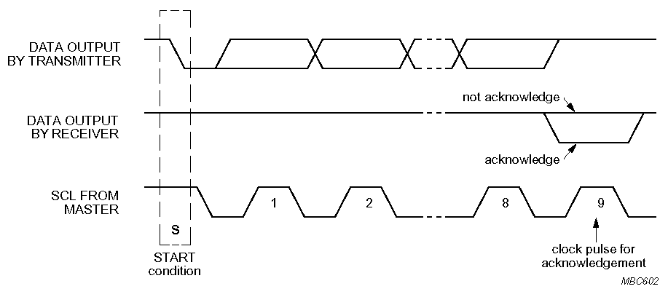
Acknowledgements
Master/slave receivers pull data line low for one clock pulse after reception of a byte
Master receiver leaves data line high after receipt of the last byte requested
Slave receiver leaves data line high on the byte following the last byte it can accept
Transmitter releases SDA line during 9th clock pulse.
Acknowledgement from receiver

Slide 17
Acknowledgements
From Slave to Master Transmitter:
  After address received correctly
  After data byte received correctly
From Slave to Master Receiver:
  Never (Master Receiver generates ACK)
From Master Transmitter to Slave:
  Never (Slave generates ACK)
From Master Receiver to Slave:
  After data byte received correctly

Slide 18
Negative Acknowledge
Receiver leaves data line high for one clock pulse after reception of a byte
Transmitter releases SDA line during 9th clock pulse.
Not acknowledgement (NACK) from receiver

Slide 19
Negative Acknowledge (Cont’d.)
From Slave to Master Transmitter:
  After address not received correctly
  After data byte not received correctly
  Slave Is not connected to the bus
From Slave to Master Receiver:
  Never (Master Receiver generates ACK)
From Master Transmitter to Slave:
  Never (Slave generates ACK)
From Master Receiver to Slave:
  After last data byte received correctly

Slide 20
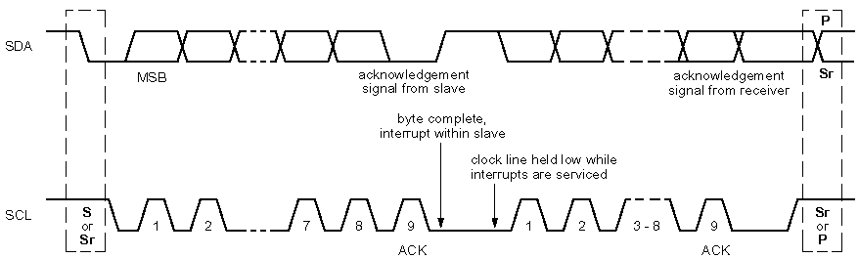
Data Transfer on the I2C Bus
Start Condition
Slave address + R/W
  Slave acknowledges with ACK
All data bytes
  Each followed by ACK
Stop Condition
SDA
ACK from Slave
ACK from Receiver
SCL
Remember : Clock is produced by Master
Stop
Start

Slide 21
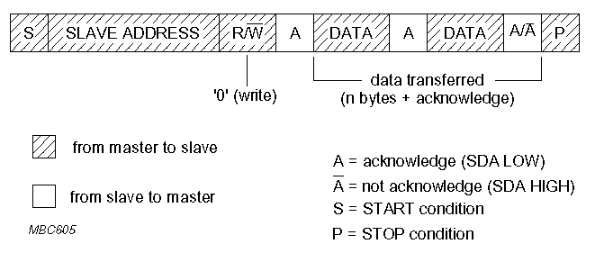
Data Formats
Master writing to a Slave
A
A
A

Slide 22
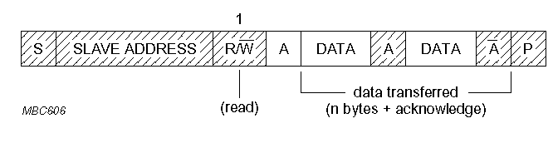
Data Formats Cont’d.
Master reading from a Slave :
Master is Receiver of data and Slave is Transmitter of data.
1

Slide 23
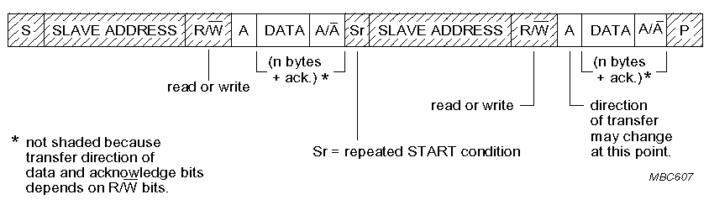
Data Formats Cont’d.
Combined Format
A repeated start avoids releasing the bus and therefore prevents another master from taking over the bus

Slide 24
Multi-master I²C Systems
Multimaster situations require two additional features of the I²C protocol
Arbitration:
  Arbitration is the procedure by which competing masters decide final control of the bus
  I2C arbitration does not corrupt the data transmitted by the prevailing master
  Arbitration is performed bit by bit until it is uniquely resolved
  Arbitration is lost by a master when it attempts to assert a high on the data line and fails

Slide 25
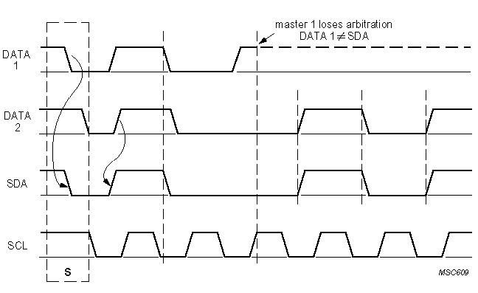
Arbitration Between Two Masters
As the data line is like a wired AND, a ZERO address bit overwrites a ONE
The node detecting that it has been overwritten stops transmitting and waits for the Stop Condition before it retries to arbitrate the bus

Slide 26
Error Checking
I²C defines the basic protocol and timing
  Protocol errors are typically flagged by the interface
  Timing errors may be flagged, or in some cases could be interpreted as a different bus event
Glitches (if not filtered out) could potentially cause:
  Apparent extra clocks
  Incorrect data
  “Locked” bus
Microprocessors communicating with each other can add a checksum or equivalent

Slide 27
Bus Recovery
An I²C bus can be “locked” when:
  A Master and a Slave get out of synch
  A Stop is omitted or missed (possibly due to noise)
  Any device on the bus holds one of the lines low improperly, for any reason
  A shorted bus line
If SCL can be driven, the Master may send extra clocks until SDA goes high, then send a Stop.
If SCL is stuck low, only the device driving it can correct the problem.

Slide 28
Type of I²C Implementations
Byte Oriented Interface
  Data is handled one byte at a a time
  Processor interprets a status byte when an event occurs
  For instance Philips 8xC554, 8xC591
Bit Oriented Interface
  Processor is involved in every bus event when the interface is not Idle
“Bit Banged”
  Implemented completely in software on 2 regular I/O pins of the microcontroller
  Works for single master systems
  Not recommended for Slave devices or Multimaster systems

Slide 29
Available I²C Devices
Analog to Digital Converters (A/D, D/A): MMI functions, battery & converters, temperature monitoring, control systems
Bus Controller: Telecom, consumer electronics, automotive, Hi-Fi systems, PCs, servers
Bus Repeater, Hub & Expander: Telecom, consumer electronics, automotive, Hi-Fi systems, PCs, servers
Real Time Clock (RTC)/Calendar: Telecom, EDP, consumer electronics, clocks, automotive, Hi-Fi systems, FAX, PCs, terminals
DIP Switch: Telecom, automotive, servers, battery & converters, control systems
LCD/LED Display Drivers: Telecom, automotive instrument driver clusters, metering systems, POS terminals, portable items, consumer electronics

Slide 30
Available I²C Devices
General Purpose Input/Output (GPIO) Expanders and LED Display Control: Servers, keyboard interface, expanders, mouse track balls, remote transducers, LED drive, interrupt output, drive relays, switch input
Multiplexer & Switch: Telecom, automotive instrument driver clusters, metering systems, POS terminals, portable items, consumer electronics
Serial RAM/ EEPROM: Scratch pad/ parameter storage
Temperature & Voltage Monitor: Telecom, metering systems, portable items, PC, servers
Voltage Level Translator: Telecom, servers, PC, portable items, consumer electronics

Slide 31
End use
Telecom: Mobile phones, Base stations, Switching, Routers
Data processing: Laptop, Desktop, Workstation, Server
Instrumentation: Portable instrumentation, Metering systems
Automotive: Dashboard, Infotainment
Consumer: Audio/video systems, Consumer electronics (DVD, TV etc.)

Slide 32
Applications
There are some specific applications for certain types of I²C devices such as TV or radio tuners, but in most cases a general purpose I²C device can be used in many different applications because of its simple construction.

Slide 33
I2C designer benefits
Functional blocks on the block diagram correspond with the actual ICs; designs proceed rapidly from block diagram to final schematic
No need to design bus interfaces because the I2C-bus interface is already integrated on-chip
Integrated addressing and data-transfer protocol allow systems to be completely software-defined
The same IC types can often be used in many different applications

Slide 34
I2C designer benefits
Design-time improves as designers quickly become familiar with the frequently used functional blocks represented by I²C-bus compatible ICs
ICs can be added to or removed from a system without affecting any other circuits on the bus
Fault diagnosis and debugging are simple; malfunctions can be immediately traced
Software development time can be reduced by assembling a library of reusable software modules
The simple 2-wire serial I²C-bus minimizes interconnections so ICs have fewer pins and there are fewer PCB tracks; resulting in smaller and less expensive PCBs

Slide 35
I²C Manufacturers benefits
The completely integrated I²C-bus protocol eliminates the need for address decoders and other ‘glue logic’
The multi-master capability of the I²C-bus allows rapid testing/alignment of end-user equipment via external connections to an assembly-line
Increases system design flexibility by allowing simple construction of equipment variants and easy upgrading to keep design up-to-date
The I²C-bus is a de facto world standard that is implemented in over 1000 different ICs (Philips has > 400) and licensed to more than 70 companies

Slide 36
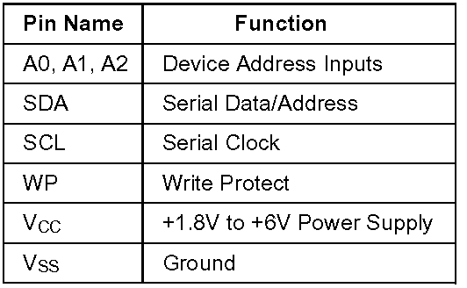
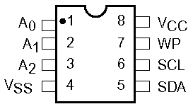
Example – EEPROM (Part 24WC32)
400 KHz I2C Bus Compatible*
1.8 to 6 Volt Read and Write Operation
Cascadable for up to Eight Devices
32-Byte Page Write Buffer
Self-Timed Write Cycle with Auto-Clear
Zero Standby Current
Commercial, Industrial and Automotive Temperature Ranges
Write Protection– Entire Array Protected When WP at VIH
1,000,000 Program/Erase Cycles
100 Year Data Retention

Slide 37

24WC32 Characteristics
32KBit memory organise as 4K x 8bit
12 address bits (2^¹² = 4K)
Device Address :
Writing
  Byte Write
  Page Write
  Write time 10mS maximum
  Write acknowledge Polling
Reading
  Immediate/Current address reading
  Selective/Random Read
  Sequential Read

Slide 38
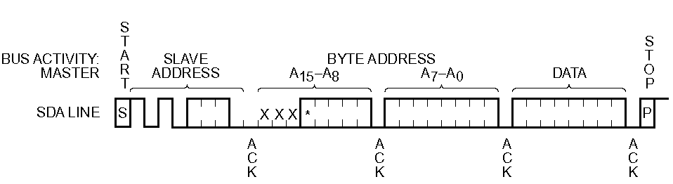
Writing a Single Data Byte
After the STOP bit is receive the device internally programs the EEPROM with the received data byte.
The programming can take up to 10ms (max.). The device will be busy during this period and will not respond to its slave address.

Slide 39
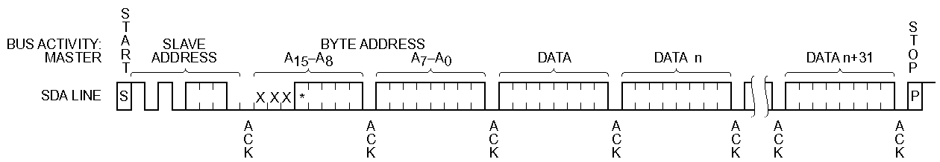
Writing Multiple Bytes (Page Write)
The bytes are received by the device and stored internally in a buffer before being programmed into the EEPROM.
A maximum of 32 bytes (one page = 32 bytes) may be written at one time for the 24WC32 device.

Slide 40
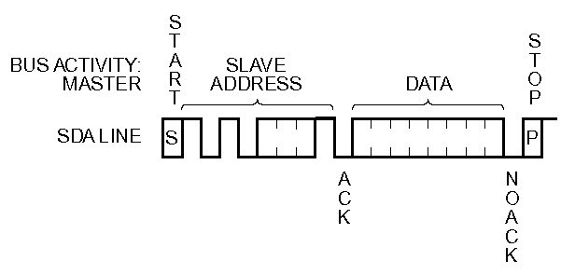
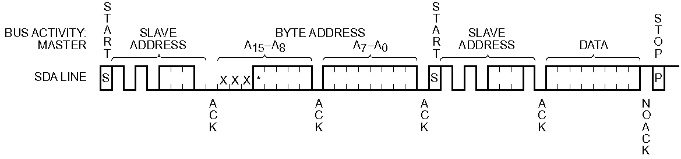
Reading EEPROM
Read current location
Read specified location – Note repeated start to prevent loss of bus during read process.

Slide 41
